Slide 1
Guelph Programming Competition
Reinaldo Reyes, Sebastian Viecco

Slide 2
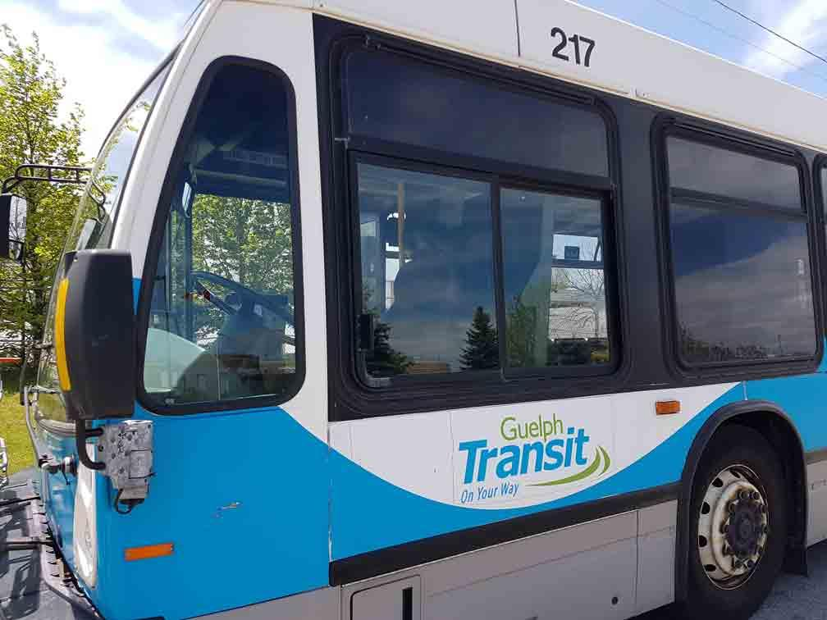
Problem Statement
The City of Guelph wants you to create an all-in-one transit application to support the citizens and incoming university students. With a centralized platform for all possible forms of transport, the city can easily manage the needs of its citizens without having to coordinate across departments. The city has thankfully saved a CSV file containing real-time information on all the routes and figures used by Guelph transit buses. At a baseline, existing bus infrastructure like stops and stations will remain fixed, and buses may only
travel between stop to stop. Ultimately, you must transport users from one place to another through any means you deem necessary.

Slide 3
DATA
routes.csv: provides all the buses with their respective IDs
trips.csv: provides all the trips for a route and provides a unique trip ID for each one
stop_times.csv: provides the arrival and departure time for each bus stop using the trip IDs and provides stop IDs
stops.csv: gives the name and position of the bus stop
shapes.csv: gives the path of the bus line and can help user know which way bus is going to or coming from

Slide 4
Process to Complete

Slide 5
A Parser For Data
ID
Routes
Location
Initial data
ID
Bus stops
Location

Slide 6
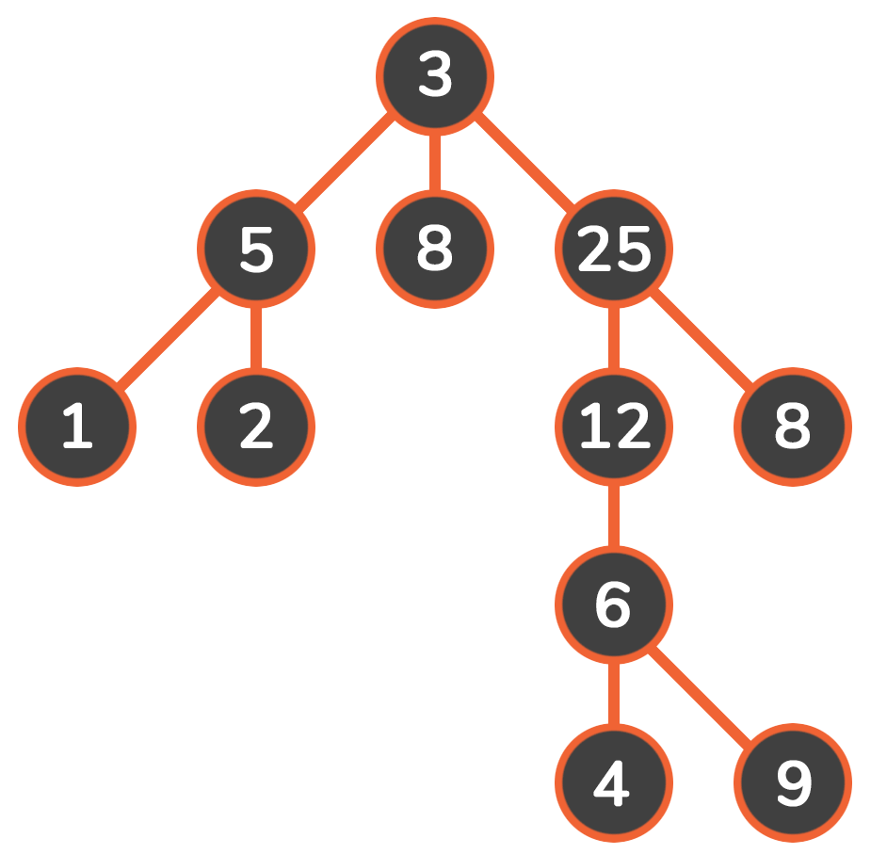
Breadth-first search (BFS)

Slide 7
Making it functional for users

Slide 8
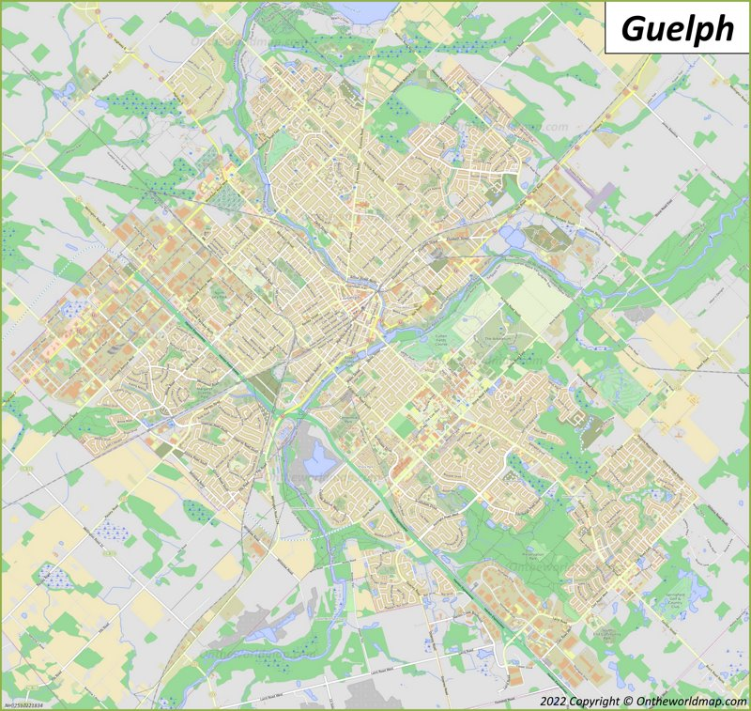
Designing The Map

Slide 9
Reference
https://blogs.oregonstate.edu/codingpatterns/2022/11/10/breadth-first-search/
https://ontheworldmap.com/canada/city/guelph/
https://guelph.ca/living/getting-around/bus/fares-and-passes/onyourway-fare-card/

